Slide 2
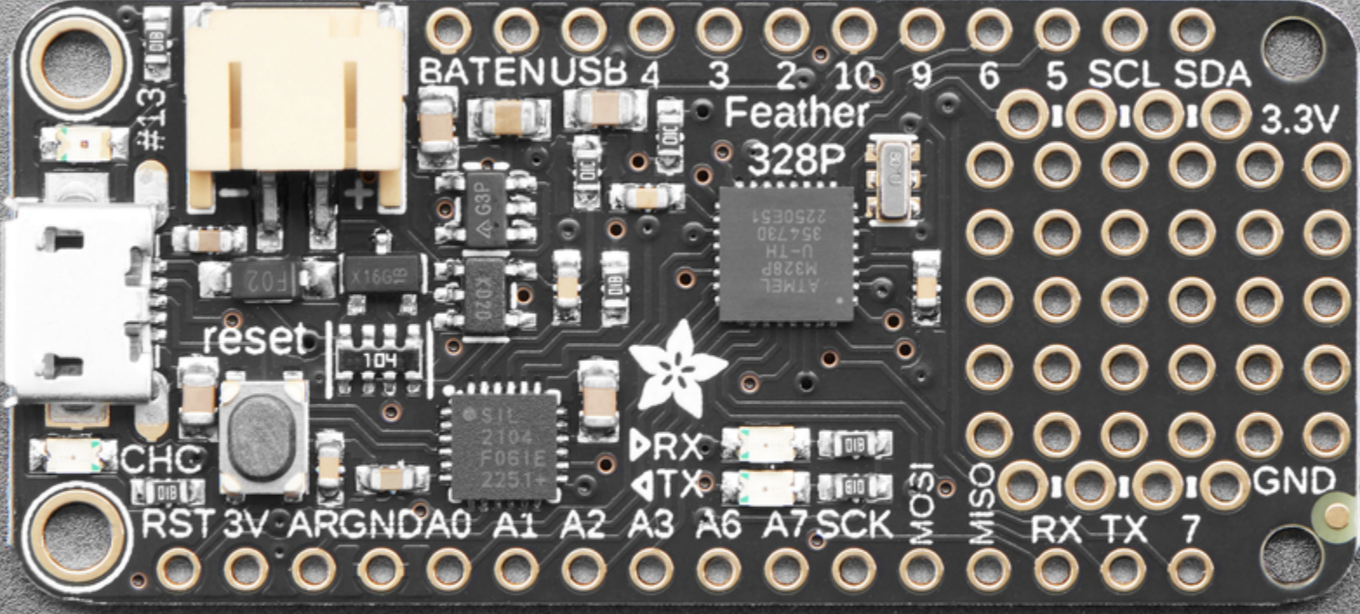
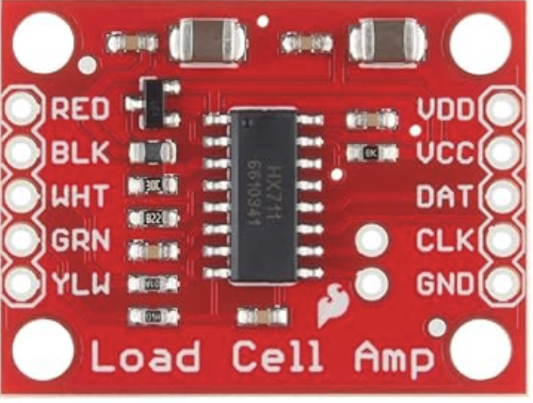
Adafruit Feather 328p Proto
Sparkfun HX711
Right Jump Plate (or unused)
Sparkfun HX11 Left jump plate or ISO Extension
Micro Controller Wiring Diagram

Slide 3
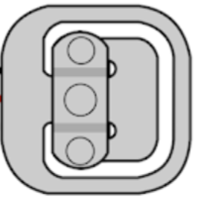
Right Plate
Left Plate
Force Plate Wiring Diagram
(wiring from load cell to Micro
Processor not included for simplicity)

Slide 4
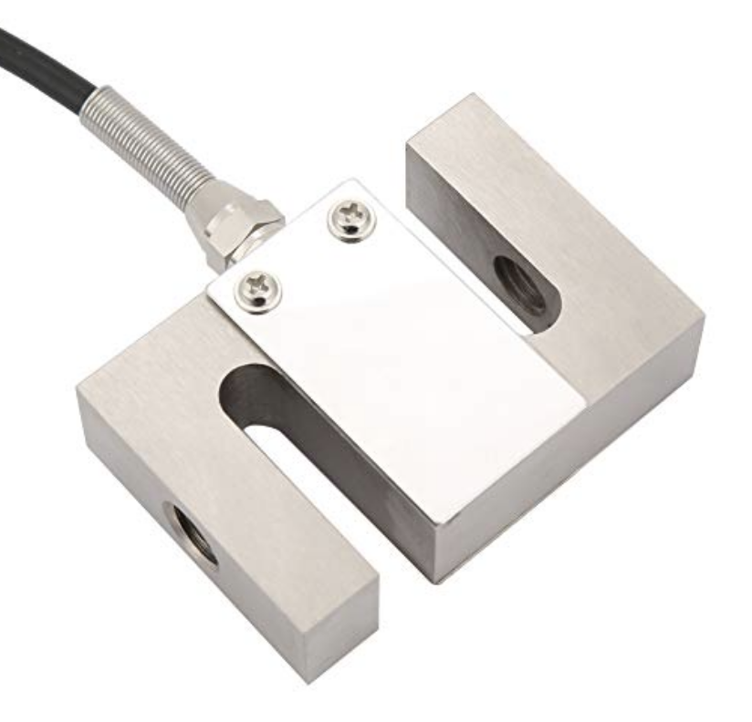
ISO Leg Extension Wiring Diagram
(wiring from load cell to Micro
Processor not included for simplicity)

